Slide 1
To replace with my own drawing

Slide 2
CSS143 Computer Programming (II)

Slide 3
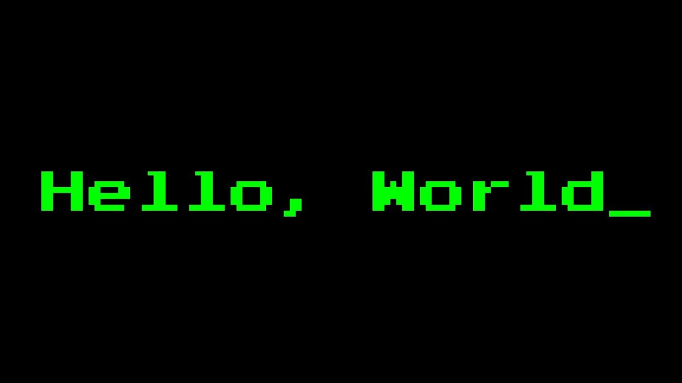
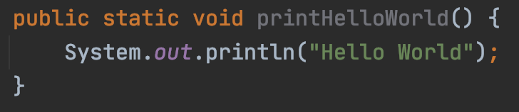
How would you test this?

Slide 4
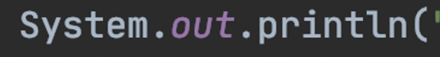
Our Code
External Dependency

Slide 5
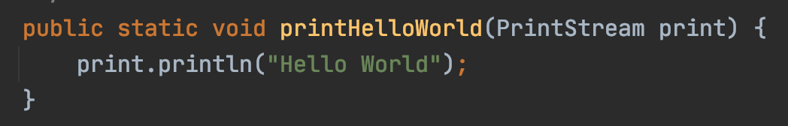
External Dependency
Our Code
Test Stub
Inversion Of Control

Slide 6
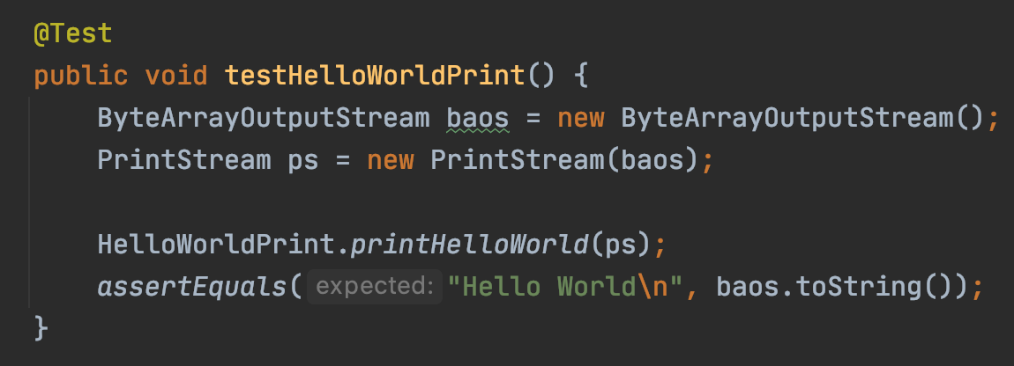
Also part of homework 3.3

Slide 7

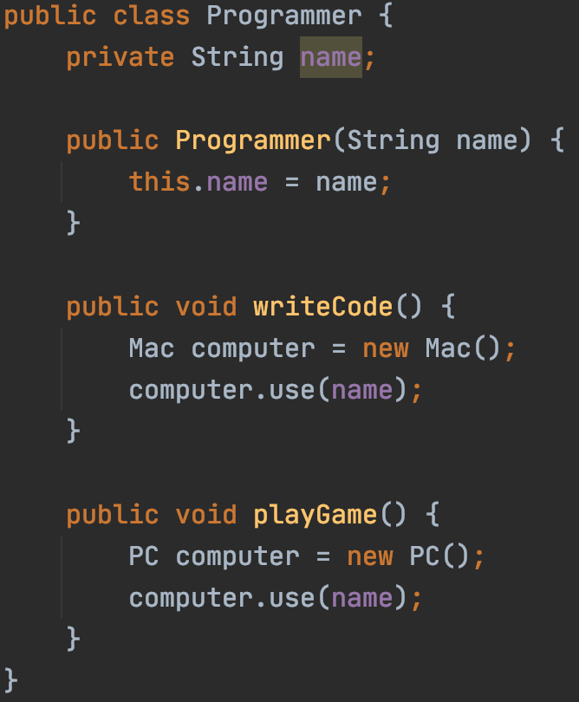
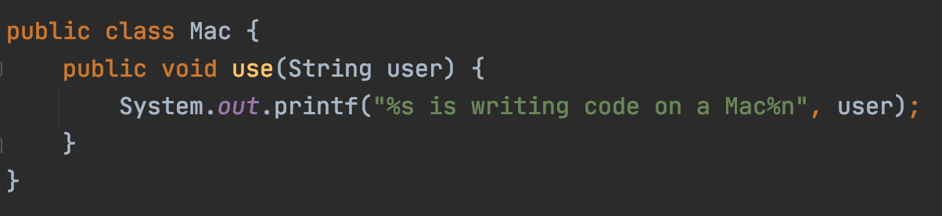
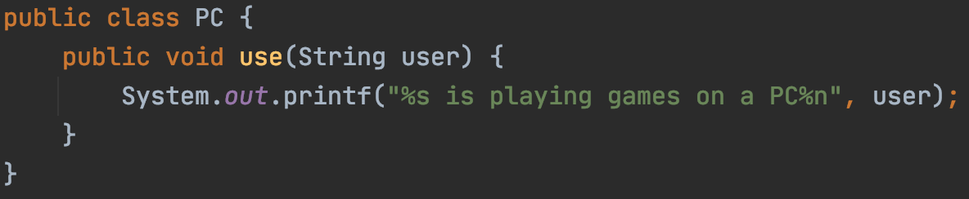
Our Code
External Dependency

Slide 8
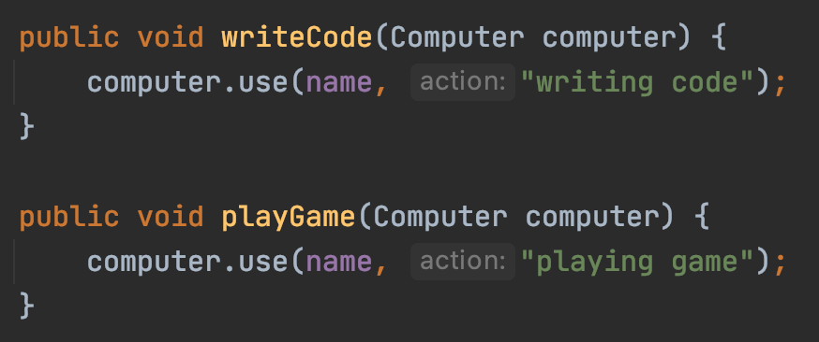
External Dependency
Our Code
Test Stub

Slide 9
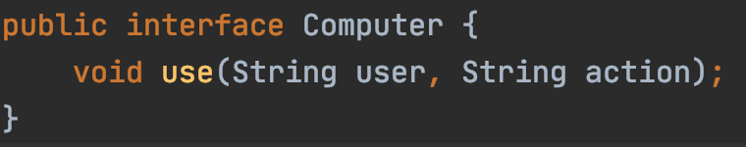
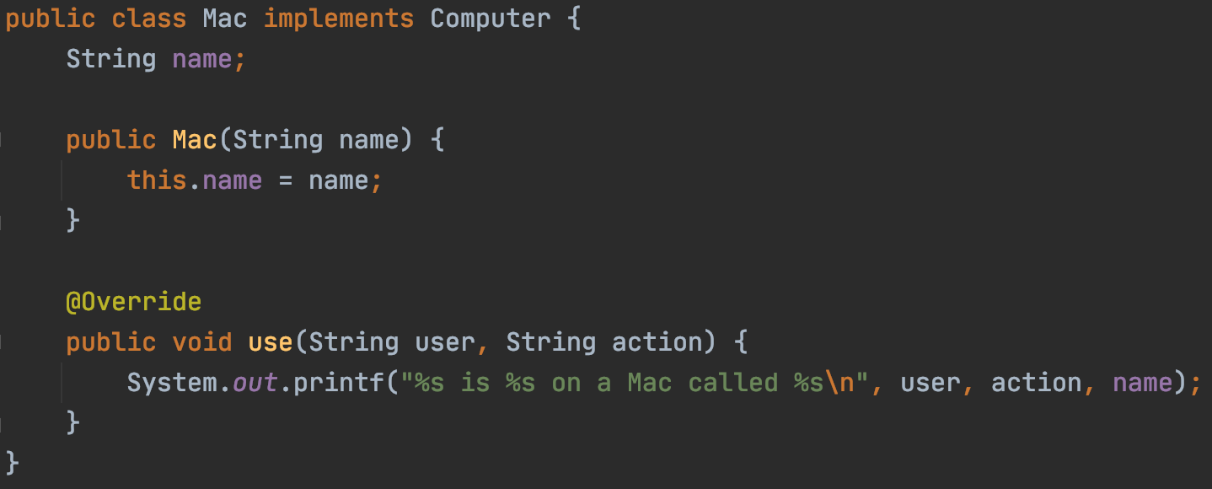
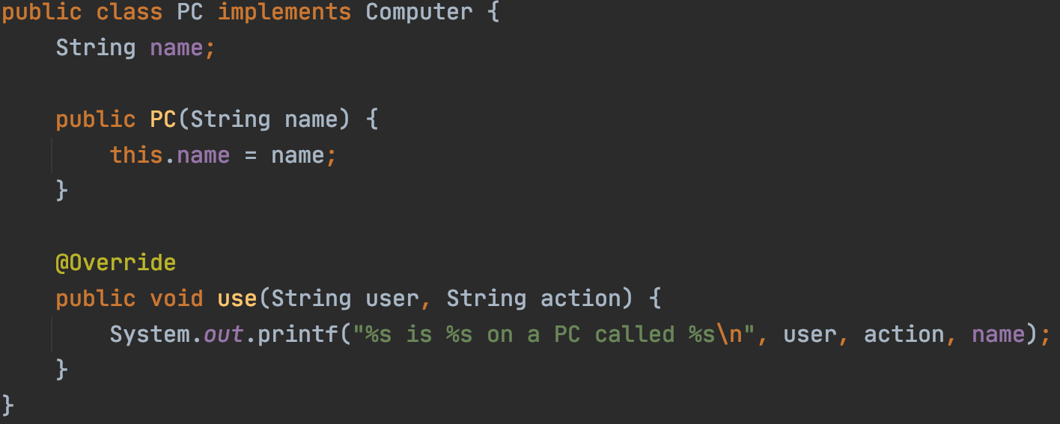
External Dependency
Our Code
Test Stub

Slide 10
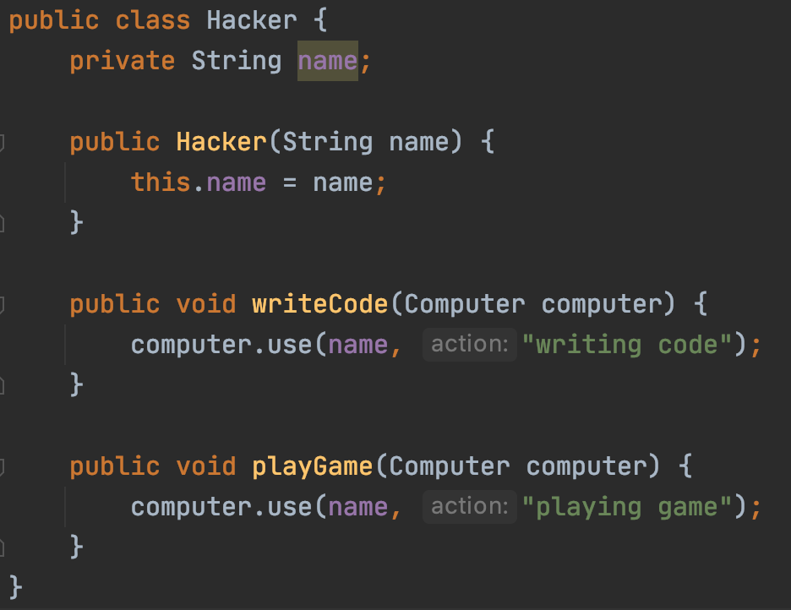
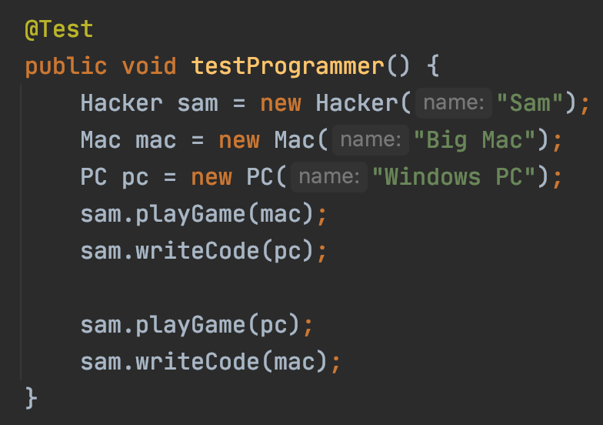
External Dependency
Our Code
Test Stub

Slide 11
Code https://github.com/pdgetrf/java-ioc

